Slide 1
Using a map visual and conditional formatting, determine which country has the most customers
By – PRAGATI SHINDE

Slide 2
Power BI Visualization:
Power BI Visualization is a way to represent data graphically using different visual elements such as charts, graphs, tables, maps and other visual elements. These visualizations helps to quickly understand and analyze data and extract insights.

Slide 3
Steps:
Understanding the data
Import the data in Power BI
Transformation of data
Map Visualization
Conditional Formatting

Slide 4
Import the data in Power BI :
Open the Power BI Desktop → Home → Get data → Excel workbook → choose file → Open

Slide 5
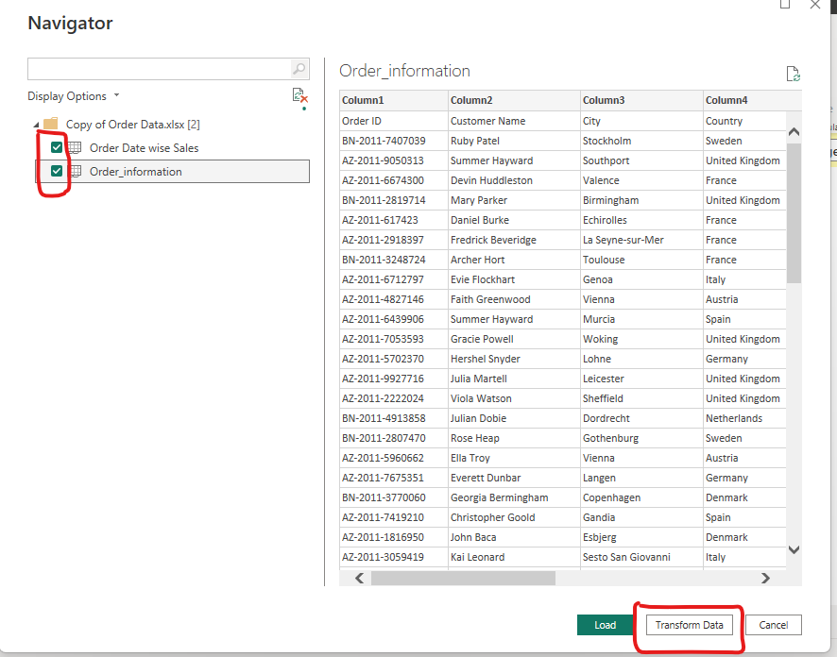
Transformation of data:
Navigator page will open →select the sheets you want to import→click on Transform data.

Slide 6
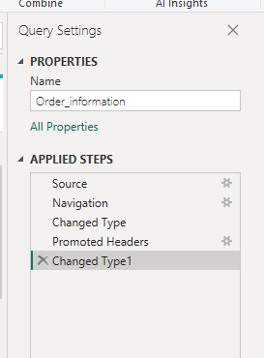
Transformation of data:
Power Query Editor window will open.
In transformation we clean the data such as Promoted headers, Removed Duplicates, Unpivoted Other Columns and Renamed Columns.

Slide 7
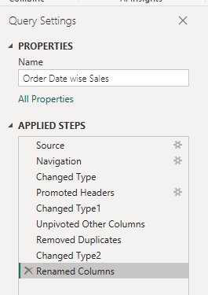
Transformation of data:
Once done with transformation .
Go to Home → click on Close & Apply.
Then it will redirect to you on Power BI Desktop.

Slide 8
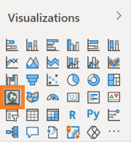
Map Visualization:
Power BI has detected all the text-based location fields like Country, State, and City as text fields; and the Postal Code as a numeric field. But, these are geo-locations.
Go to Report View → Insert → Visual Gallery → Select Map.

Slide 9
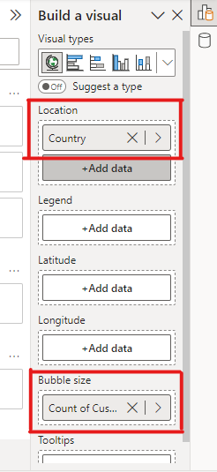
Map Visualization:
Go to Data Pane → select Country and Customer Name.
Select Build a Visual → Select options as shown in fig.

Slide 10
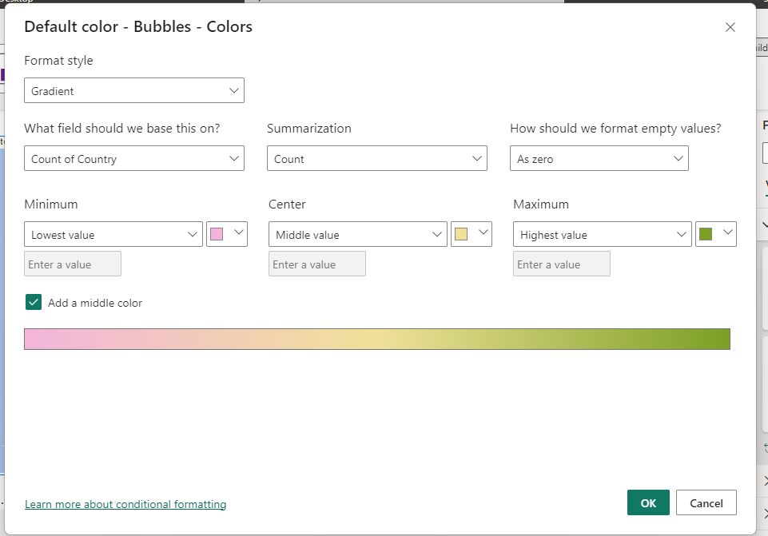
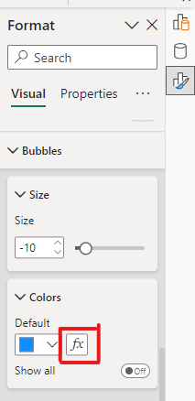
Conditional Formatting:
Go to Format Pane → Visuals → Bubbles → Colors → select conditional formatting → format like fig. → OK.

Slide 11
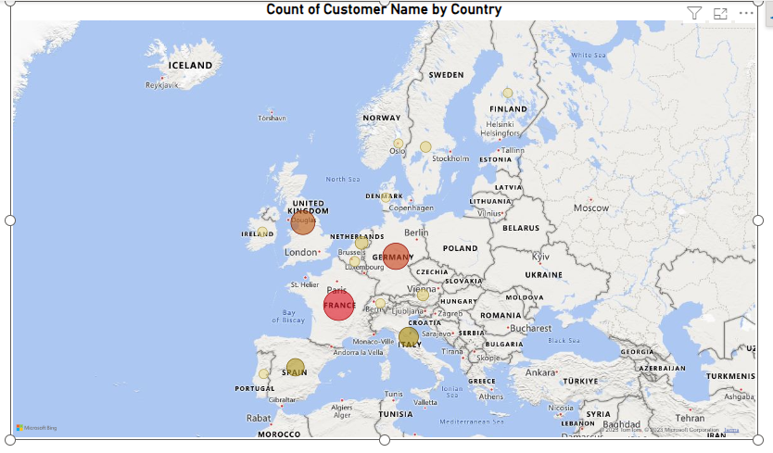
FRANCE country has the most customers

Slide 12


